Slide 1

OPENMP THREADING PERFORMANCE FOR MERGE SORT ALGORITHM
Team D:
Shashank Koundinya Cheruku
Brindavani Sunkari
Thursday, May 11, 2017
Supervisor:
Mr. John Leidel
PhD Student
Texas Tech University

Slide 2
CONTENTS
Introduction
Problem Statement
Motivation
Proposed Research
Code
Analysis
Cilksort
Results
Future Work

Slide 3
INTRODUCTION
OpenMP is an API that supports multi-platform shared memory multiprocessing programming.
Used for parallel execution and parallelism can be controlled by specifying the number of threads.
Advantage of using OpenMP over pthreads is its portability.
Current version is 4.5 and 5.0 is under review.

Slide 4
PROBLEM STATEMENT
OpenMP clauses have an overhead associated with it.
This overhead is caused by fork and join latency.
This overhead causes delay in the execution when implemented on large data.
We calculate the overhead against no. of threads.

Slide 5
MOTIVATION
Parallel execution is done for faster implementation.
But, overheads cause the delay in its execution.
Merge Sort is the efficient algorithm of all the sorting techniques.
So, we would like to analyse the overhead for Merge Sort using OpenMP directives.

Slide 6
PROPOSED RESEARCH
We implement 2-stage parallel algorithm to differ the overhead from initial latency.
We implemented the merge sort using:
Sections
Tasks
We analyzed these benchmarks for 3 different platforms for 1 to 2*N no. of cores.

Slide 7
PROPOSED RESEARCH
Processor | Operating System | Compiler
Twelve-Core AMD Opteron Processor @ 1.8Ghz 64GB Memory | Ubuntu 16.04 LTS Kernel: 4.4.0-66-generic | gcc 5.4.0 2016609
Sixteen-Core Intel Xeon CPU E5-2650 @ 2.6Ghz 64GB Memory | CentOS Release 6.5 disci.hpcc.ttu.edu | gcc 4.4.7 20120313
Dual-Core Intel Core i5-2410M CPU @ 2.30GHz 4GB Memory | Ubuntu 16.04.2 LTS | Cilkplus compiler gcc 4.9.0 20130520

Slide 8
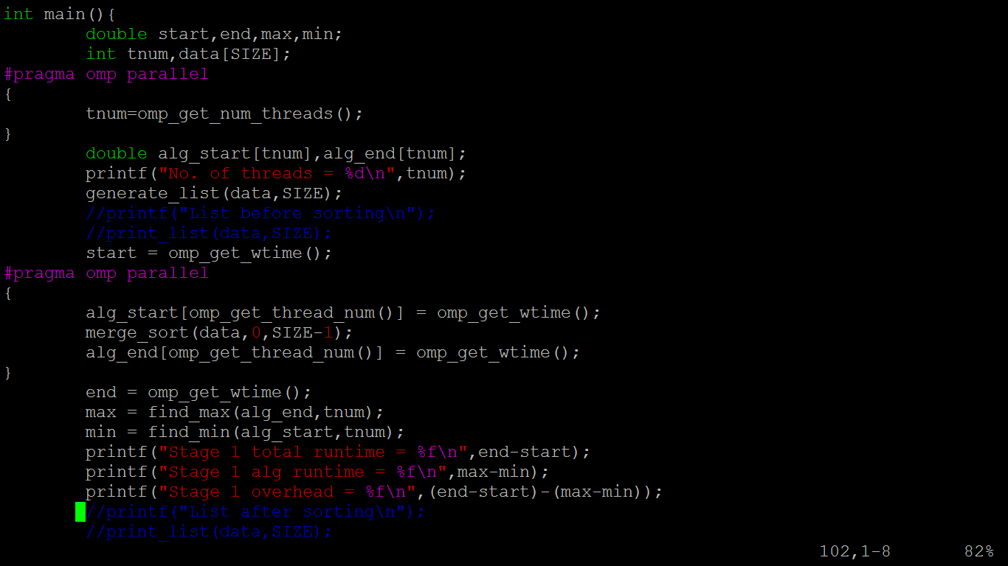
MAIN FUNCTION

Slide 9
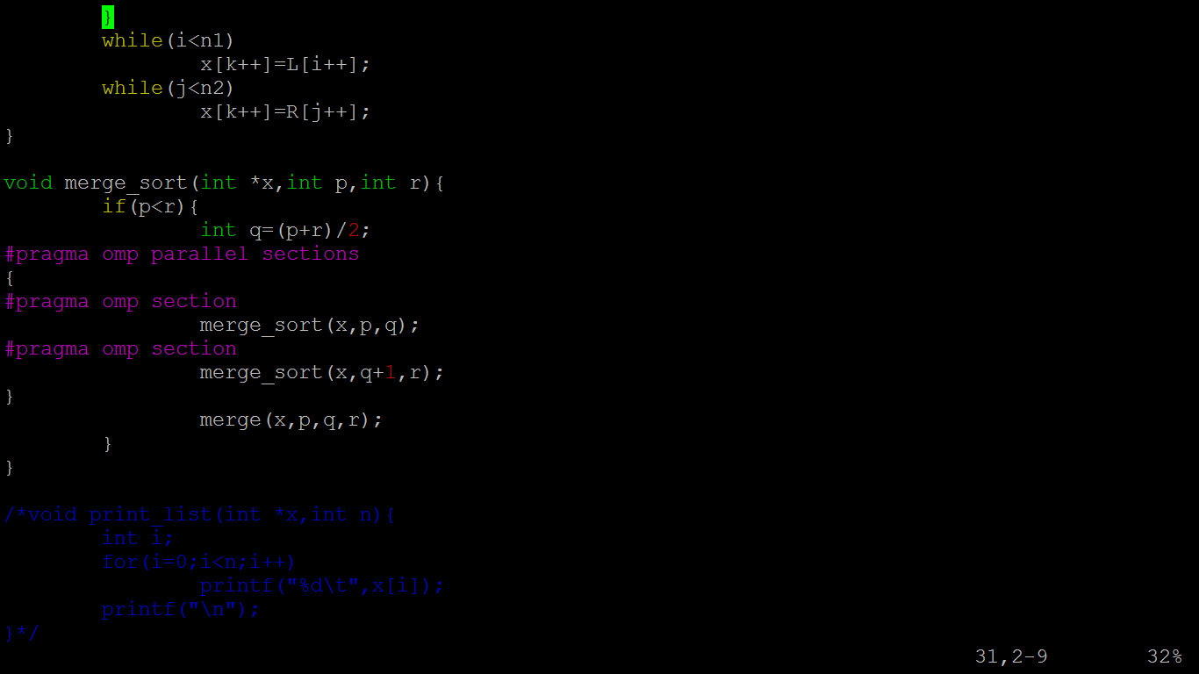
SECTIONS

Slide 10
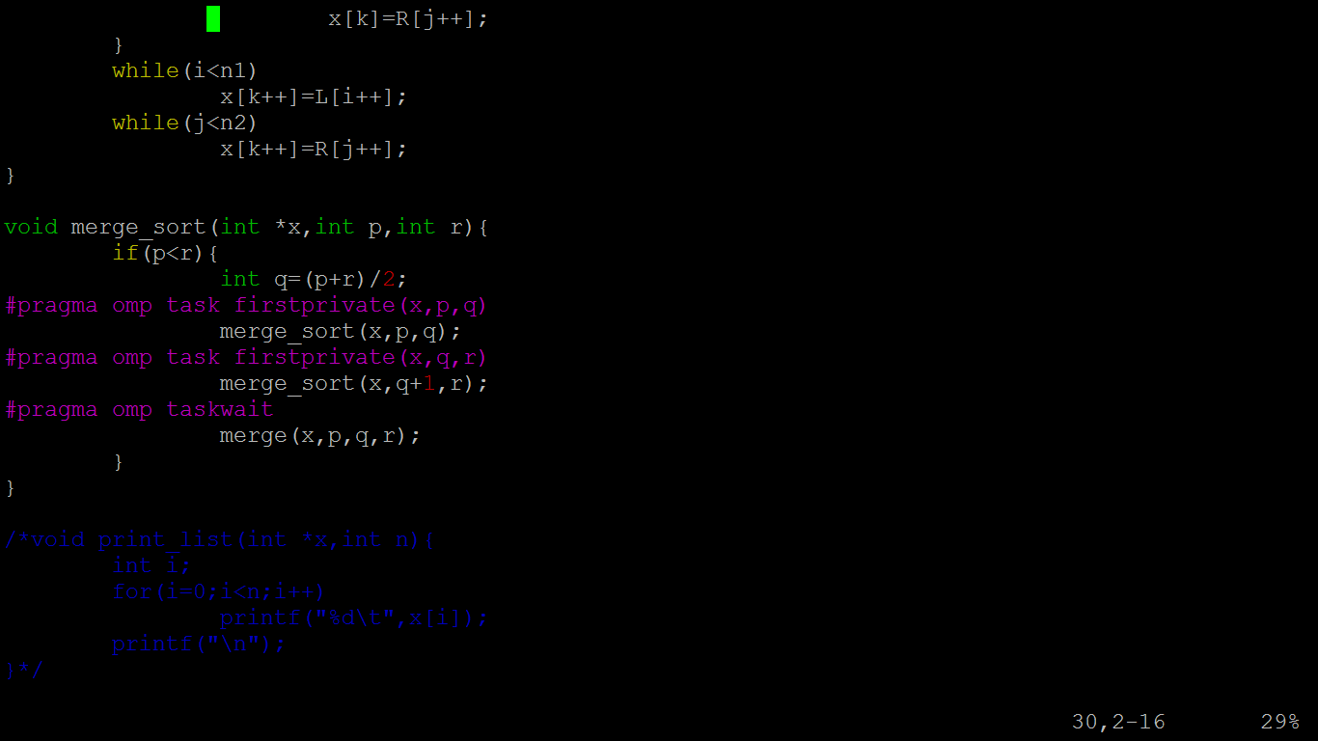
TASKS

Slide 11
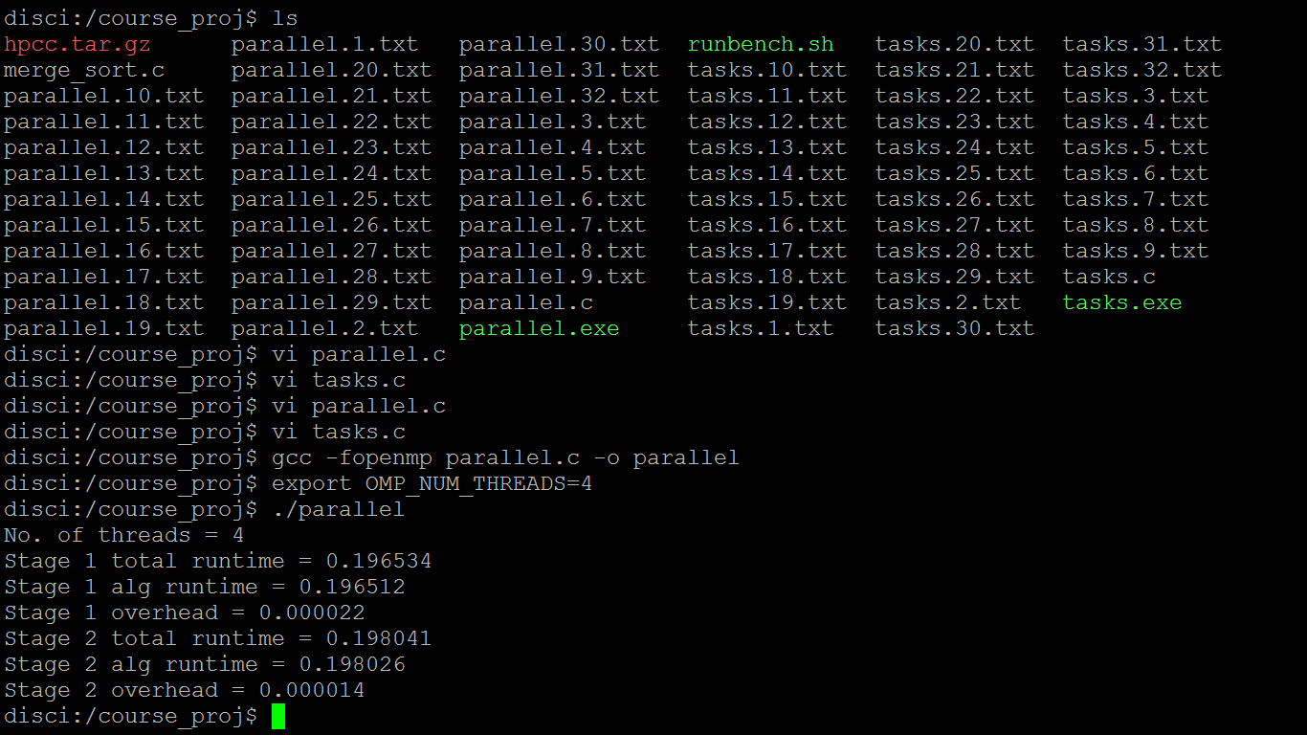
SAMPLE OUTPUT

Slide 12
ANALYSIS

Slide 13
ANALYSIS

Slide 14
CILKPLUS COMPILER
Another implementation of the parallel execution by Intel Corporation.
It is an extension to the C and C++ languages to support data and task parallelism.
It is not just a library but it is a language extension to C and C++ compilers.
Requires Intel Parallel Studio XE and Visual Studio for Windows. So, we installed it in Ubuntu.

Slide 15
CILKPLUS COMPILER
Advantages over OpenMP:
Very few keywords to implement task parallelism.
Automatic load balancing.
Includes Reducers which provide a lock-free mechanism.
Has low cost spawning, so good for highly recursive code.

Slide 16
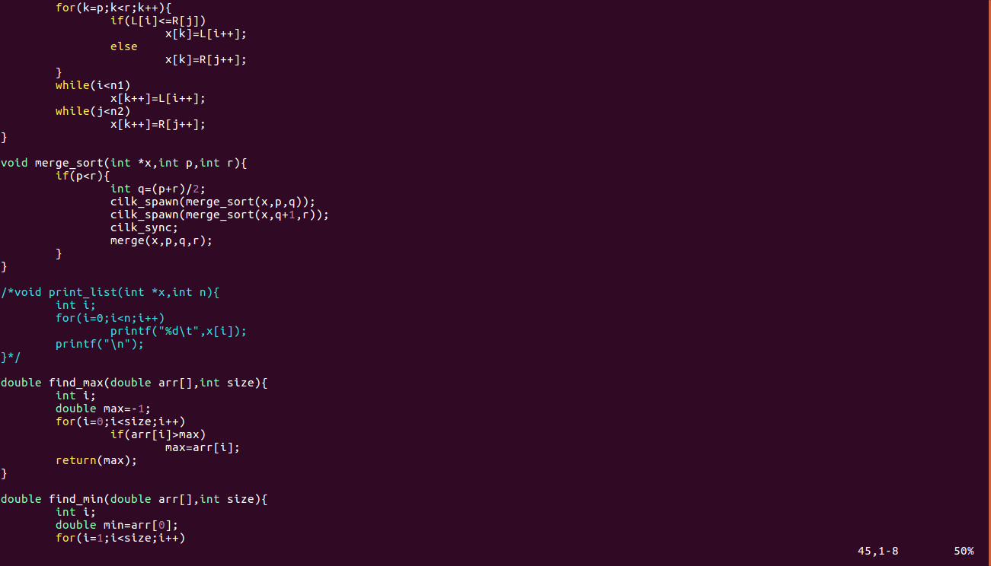
CILKSORT CODE

Slide 17
CILKSORT ANALYSIS

Slide 18
RESULTS
Task algorithm performs better than the sections algorithm.
The overhead associated with the threads increases with the number of threads.
This is due to the scaling issues of the merge sort algorithm for large datasets.
Cilksort comparatively performs better than the OpenMP algorithms.

Slide 19
FUTURE WORK
Overhead can be calculated for the Cilksort Algorithm and compared with OpenMP Algorithms.
Develop a more efficient algorithm to reduce the overheads.
Performance Implications of cilksort can be calculated among different Operating Systems.

Slide 20
THANK YOU!

